Slide 1
Multi Model
(Cascade of Experts)

Slide 2
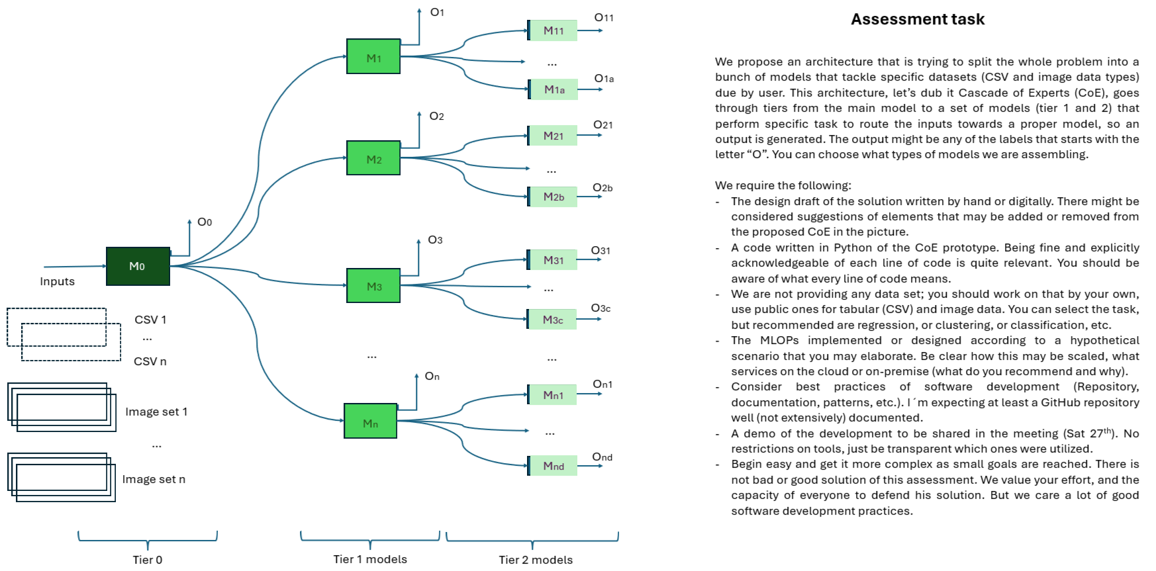

Slide 3
Project Description
The Dataset used is related to the medical images of cancer classification
The Idea is to for the image classification is to classify the Kidney, Brain, Pancreases, Skin cancer and their sub classification when the image is fed into the model
As for the csv input classification classify if the given row is malignant or benign

Slide 4
Models & its accuracy
CSV classification:
Cancer Classification – SVM - 99
Breast Classification – KNN – 97
Image Classification:
Image Router – Resnet18 – Trained on 6000 images(All images) – 99%
Brain - Resnet18 - Trained on 4000 images (Brain Images alone) – 99%
Kidney - Resnet18 - Trained on 6000 images (Brain Images alone) – 99%
Pancreases - Resnet18 - Trained on 3000 images (Brain Images alone) – 99%
Skin - Resnet18 - Trained on 10000 images (Brain Images alone) – 89%

Slide 5
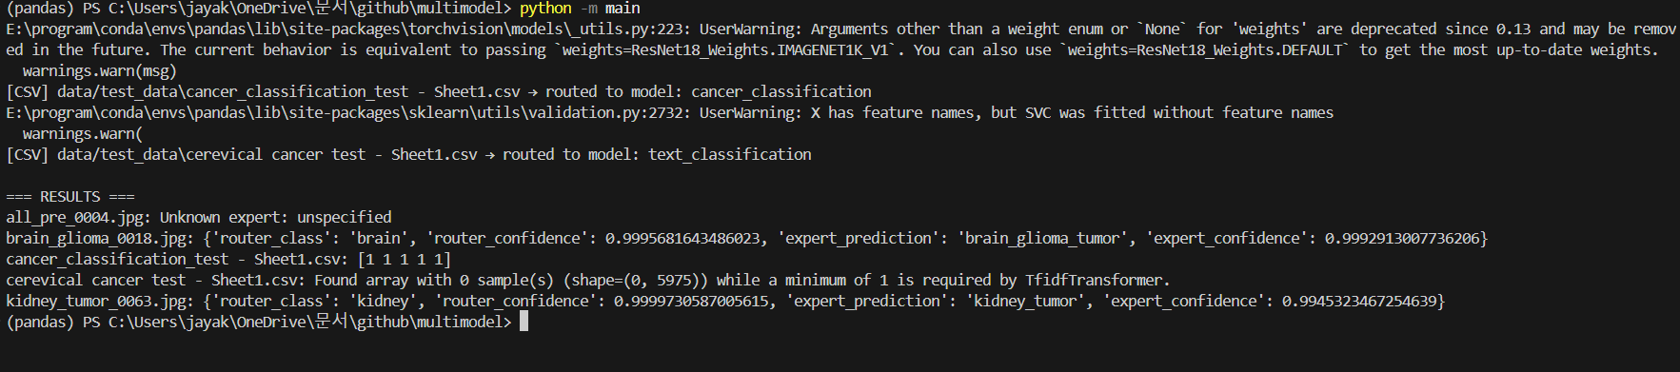
Result

Slide 6
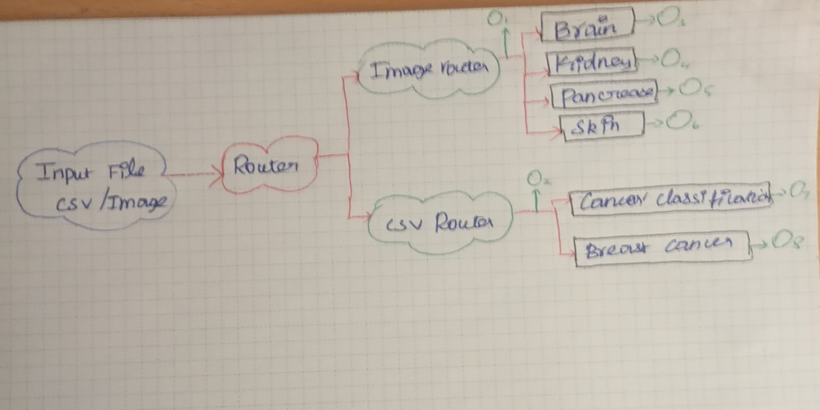
Cascade Of Experts:

Slide 7
Scalable ideas:
AWS for cloud services
Docker to run in any devices
Kubeflow to manage pipelines, models, notebook
CI/CD for models -> GitHub Actions + Jenkins
REST/gRPC via FastAPI

Slide 8
Further Improvements:
CSV pipeline needs further improvements on able to manage different type of dataset which including preprocess in the pipeline.
Pipeline prediction is off for the csv model

